Slide 1

The Business Process
Presented By:
Veronica Hernandez, Joye Jewell, Evelyn Suber, & Lisa Vinje
ACC/340
April 8, 2019
Professor Ralph Petrillo

Slide 3
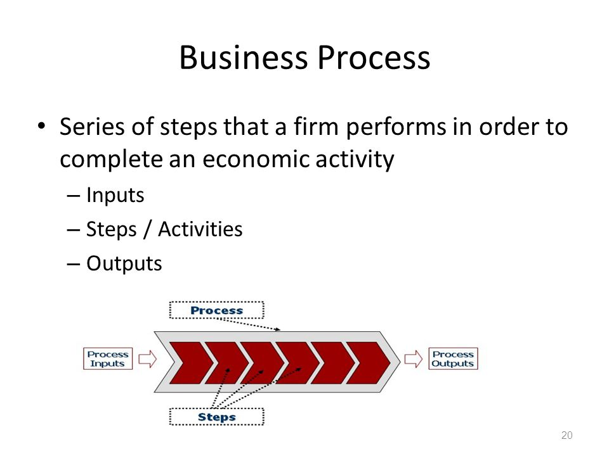
BUSINESS ACTIVITY PROCESS
Notes:
A business activity process is a collection of activities/tasks that uses resources to convert inputs into outputs to accomplish the business’s strategic goals (Richardson, Chang, & Smith, 2014,).

Slide 4
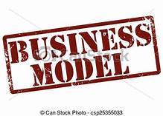
BUSINESS MODELS
Notes:
For a business to achieve its strategic goals, it is imperative for an accountant to understand how the business process is operated. Some of the business activities can be challenging to understand. For this reason, a business analysis (Accountant) can design a business model to visually understand the more challenging processes. A business model portrays and characterizes the various activities and the workflow of the business process. It is valuable that the business model is precise and clear. When the business models are precise and clear, it will help managers to make changes to its operations to be more efficient and effective to achieve their goals (Richardson, Chang, & Smith, 2014,).

Slide 5
EFFECTIVE BUSINESS MODEL
Events
Activities
Sequence Flows
Gateways
Annotations
Notes:
For a business model to be precise and clear it must represent the following:
All events that occur and affect the process from start to finish.
Activities or tasks that are within the business processes.
Arrows that illustrates the sequence or the flow of the various activities in the process.
All the various decisions that could affect the outcome also known as gateways.
Annotations that the analysts can document any meaningful information to make the model more clear (Richardson, Chang, & Smith, 2014,).

Slide 12
References
Richardson, Vernon J., Chang, C. J., & Smith, R. (2014).
ACCOUNTING INFORMATION SYSTEMS. Retrieved from
The University of Phoenix eBook Collection database.
Notes:
References page

